Slide 1
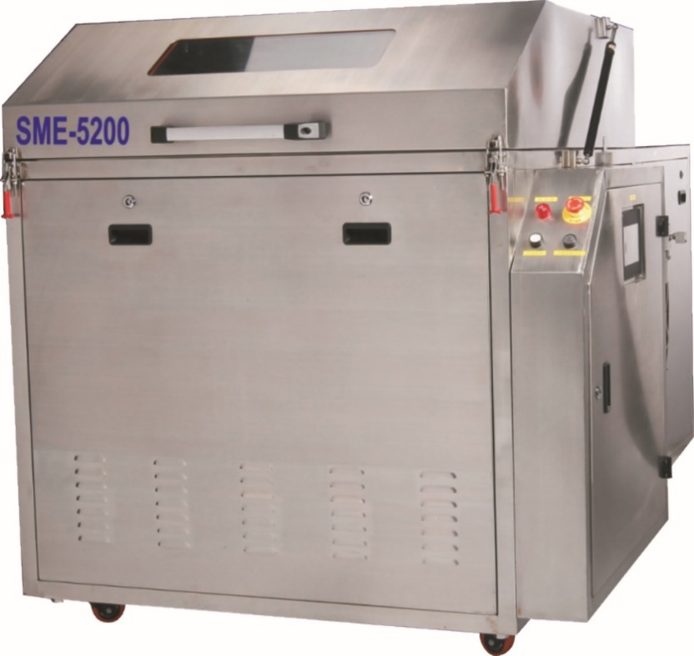
Professional Cleaning Equipments Supplier for SMT, PCB,Semi-conductor
SME-5200 introduction
SME-5200 Fixture Cleaning Machine is used to clean grease, flux, dusts on the surface of all kinds of SMT fixtures，tray, reflow oven cooler and filter, wave-soldering oven claw, chains, and nets…etc.
SME-5200 is made up of wash unit, rinse unit, dry unit, rotation cleaning basket unit and control unit. Put the dirt SMT fixtures on to the cleaning basket, setting the cleaning parameters, the machine will automatically complete wash, rinse and dry process by just pushing start key. The fixtures after cleaning is very clean and dry, ready to use at any time.

Slide 2
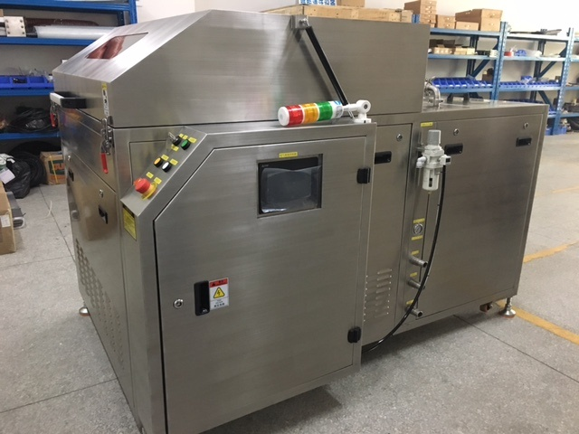
Professional Cleaning Equipments Supplier for SMT, PCB,Semi-conductor
SME-5200 pictures

Slide 3
Professional Cleaning Equipments Supplier for SMT, PCB,Semi-conductor
SME-5200 cleaning obojects
Reflow oven/Wave oven fixture, plate
Composite stone, Steel, Aluminum materials
Fixuture cleaning
Reflow oven/Wave oven maintenance
Cooler, filter, chains…
Any machine parts with flux on them
Parts cleaning
Grease,oil on plastic, hardware, electrical-parts
Any parts which can be cleaned

Slide 4
Professional Cleaning Equipments Supplier for SMT, PCB,Semi-conductor
Fixture Manual cleaning difficulties
Iron brush scratch clean, not safe
Difficulties
Professional cleaning staff
long time, low efficient, one by one clean
High labor cost
Fixture
Fixture surface damage
Very dirty, hard to clean
Unpleasant smell, harmful to operator health

Slide 5
Professional Cleaning Equipments Supplier for SMT, PCB,Semi-conductor
SME-5200 machine auto cleaning advantages
Advantages
Environmental-protetion
Easy operation
Save cleaning liquid , cost down
batch cleaning , efficient
SME-5200
Fixture cleaning machine
Less time to contact liquid
No damage to fixture
Hot air dry
All aspects cleaning

Slide 6
Professional Cleaning Equipments Supplier for SMT, PCB,Semi-conductor
Fixture cleaning process flow chart:
Put fixtures into round basket, press start key to start clean
clean pump start and draw liquid from liquid tank
20um filters
Liquid recyclely used
nozzles 720°，all aspects spray liquid
Spray clean liquid to clean fixture
Rinse pump start
720° all aspects spray water to rinse
water recyclely uesd
Spray water to rinse fixture
Hot air blow dry
Machine stop , take out fixtures

Slide 7
Professional Cleaning Equipments Supplier for SMT, PCB,Semi-conductor
SME-5200 Feature:
. Total SUS 304 structure, resist Acid and Alkali corrosion, firm and attractive.
1 meter diameter big cleaning round basket, can clean 20~40 pcs fixtures at one time.
Clean liquid spray from 3 spray rods on upper/lower and front side, cleaning basket rotates during cleaning.
Clean liquid pressure up to 6kg/cm2, make it throughly clean of whole fixture.
PLC program control, Touch-panel operation，cleaning parameters can be set and change conveniently.
Easy One-button operation, high pressure clean+ rinse+ hot air dry, all process complete in a cycle automatically.
Clean liquid and water heat and temperature keeping function.
Closed-loop clean and rinse, clean detergent and rinse water are cycling filtered and reused in the machine.
Standard equipped solution and water auto fill in and discharge function.
The fixtures are clean and dry after cleaning, standby and ready for use at any time.

Slide 8
Professional Cleaning Equipments Supplier for SMT, PCB,Semi-conductor
SME-5200 SPEC:
.
Item | SME-5200 Spec
Cleaning basket size | Φ1000mm x H 200mm. Special size option
Spray unit | Upper/lower/front side,720°all-around spray
3-level filter system | 1mm /50um/20um filters
Clean tank capacity | 80L
Rinse tank capacity | 80L
Clean spray pressure | 5~6 kg/cm2
Clean time | 5~15 Min
Rinse time | 1~3 Min
Dry time | 10~20Min
Clean detergent heat temp | Room temp~80℃
Rinse water heat temp | Room temp~80℃
Hot air heat temp | Room temp~90℃
Clean pump power | 2.2KW
Clean detergent power | 9KW
Hot air heat power | 9KW
Air blower power | 4.0KW
Air supply | 0.5~0.7Mpa
Power supply | 3 P,AC 380V,50/60HZ,33KW
Machine size | L1380 x W2100 x H 1400 (mm)
Machine weight | 500KG

Slide 9
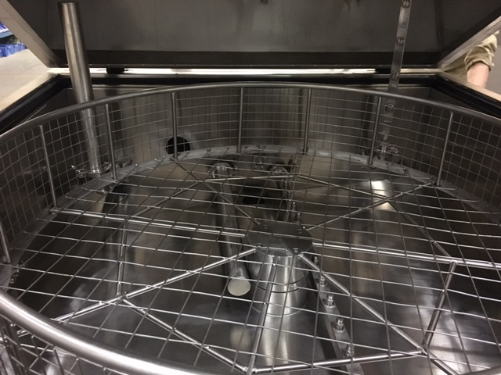
Professional Cleaning Equipments Supplier for SMT, PCB,Semi-conductor
1.Cleaning Basket
A. 1m diameter round cleaning basket, batch clean fixture, basket turns during clean, rinse and dry process。
B. clean-rinse- dry , the total process time is 30~40min

Slide 10
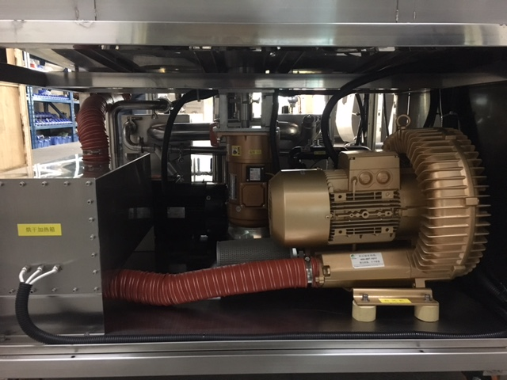
Professional Cleaning Equipments Supplier for SMT, PCB,Semi-conductor
2. Pumps and air blower
A.High quality, big flow cleaning pumps。
B. High flow rate blower, reduce hot air dry time 。

Slide 11
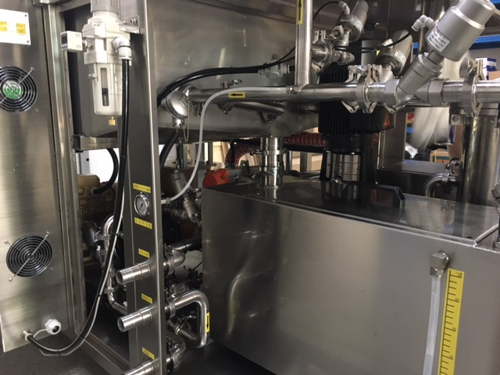
Professional Cleaning Equipments Supplier for SMT, PCB,Semi-conductor
3.Liquid tank/water tank/SUS304pipes/auto liquid/water fill in and drain out function
A. Total SUS304 machine。
B. Auto liquid/water fill in and drain out function.
C. Liquid tank and water tank and separated pipe system

Slide 12
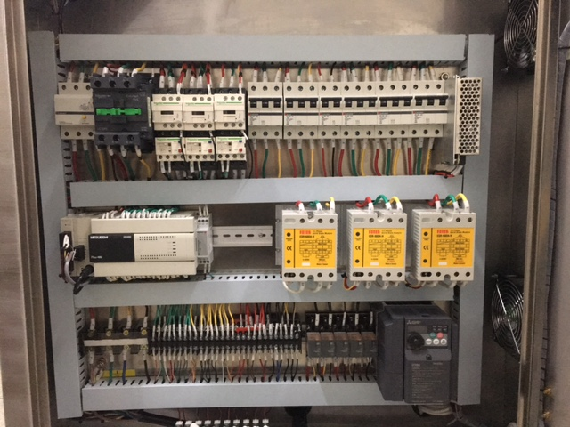
SME—Professional Cleaning Equipments Supplier for SMT, PCB,Semi-conductor
4.Control System
A. Famous electric devices：Mitsuibish PLC, Touch panel，Inventor，Schneider Contactor，Relay，CKD solenoid valve，OMRON power unit。
B. Isolated and protected power supply and distribution system

Slide 13
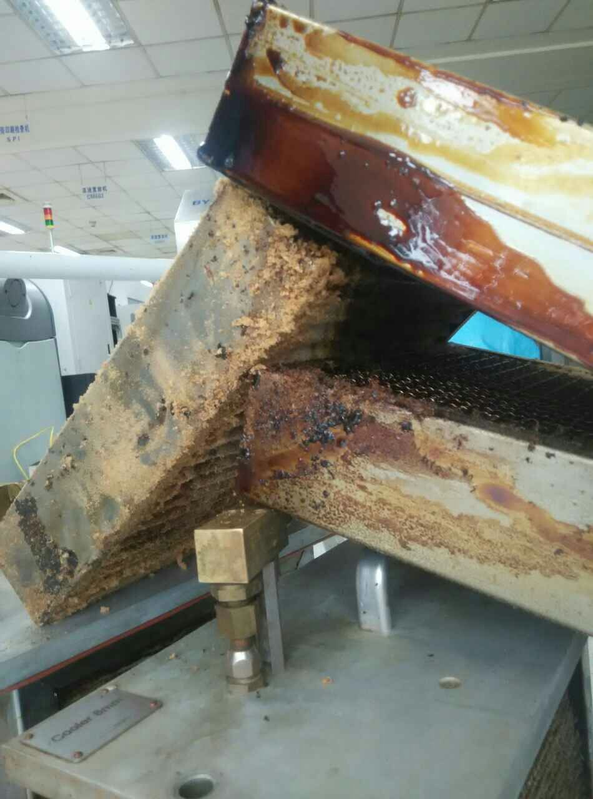
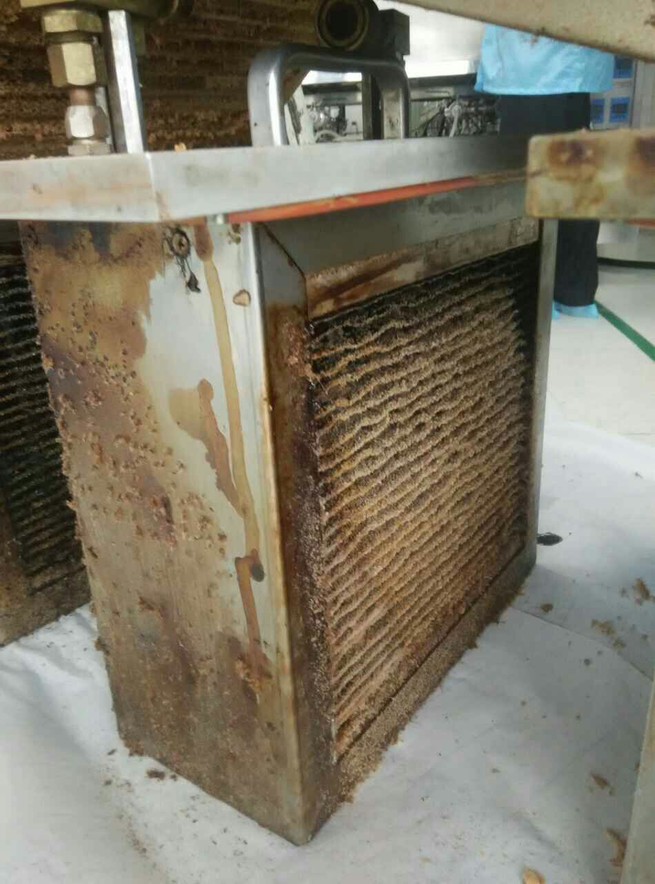
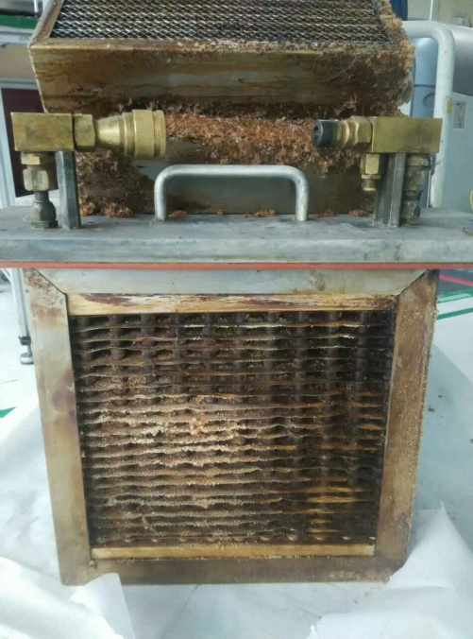
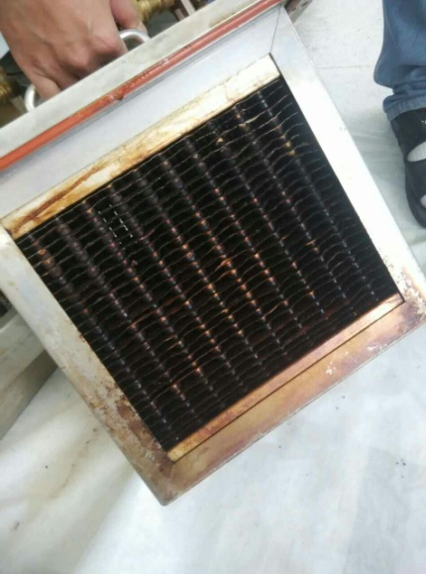
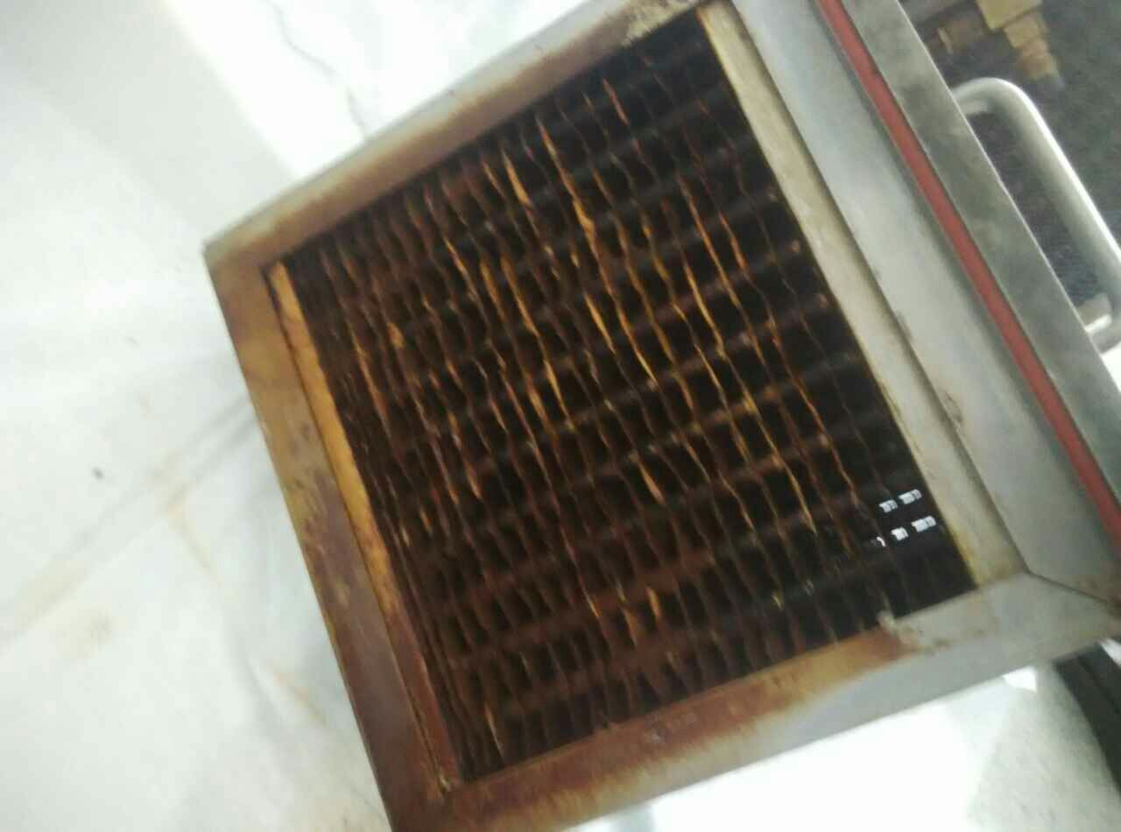
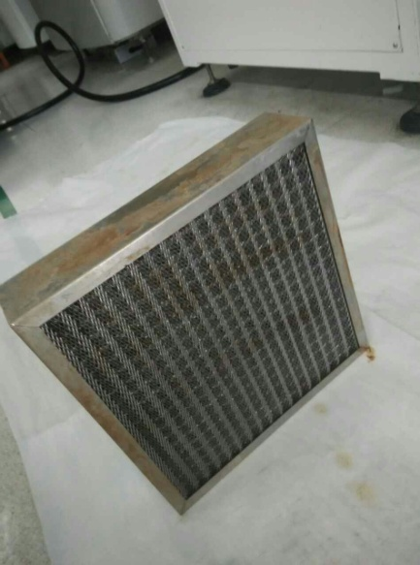
Professional Cleaning Equipments Supplier for SMT, PCB,Semi-conductor
SME-5200 Reflow oven cooler cleaning comparison:

Slide 14
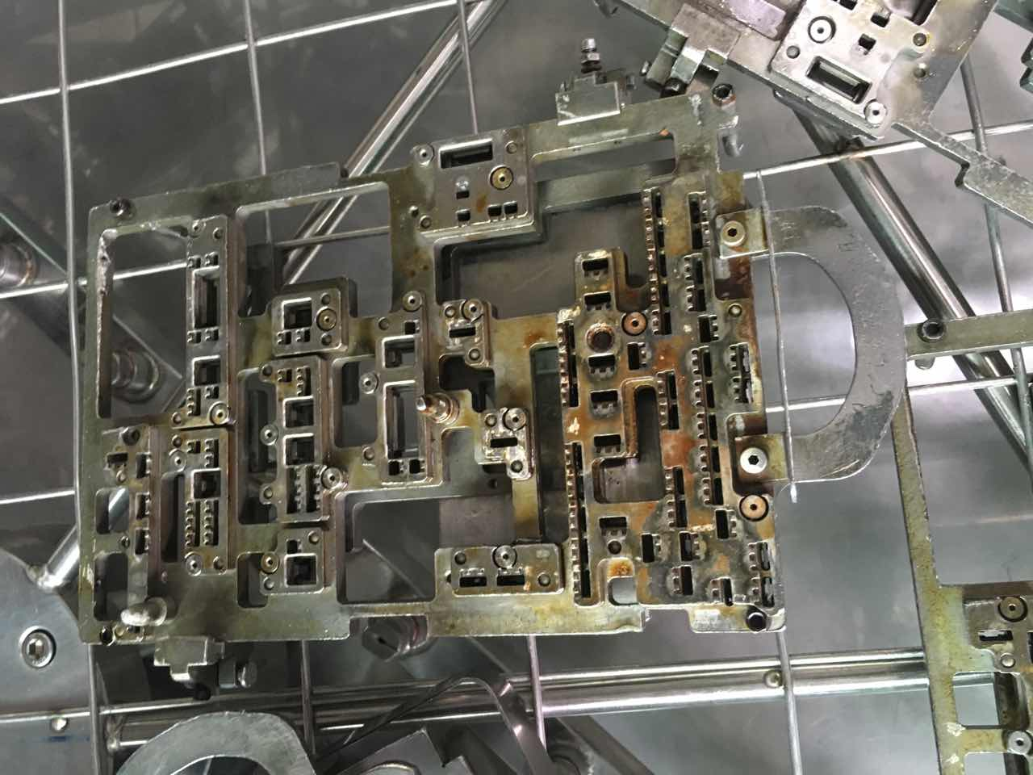
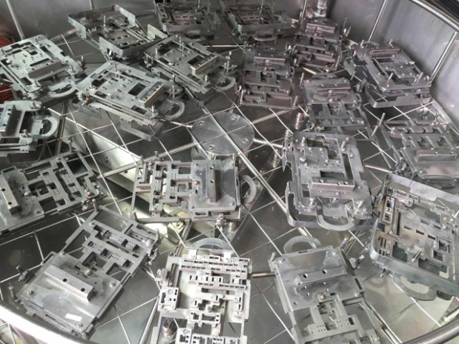
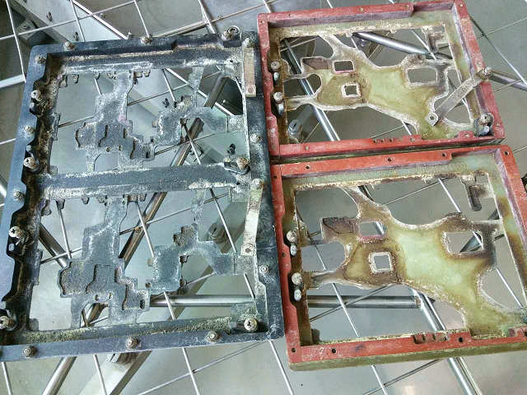
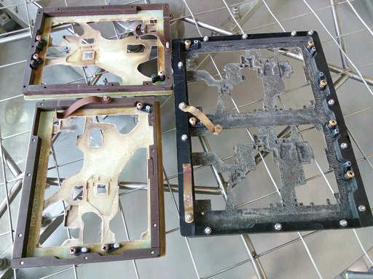
Professional Cleaning Equipments Supplier for SMT, PCB,Semi-conductor
SME-5200 wave oven fixture cleaning comparison:

